Slide 1
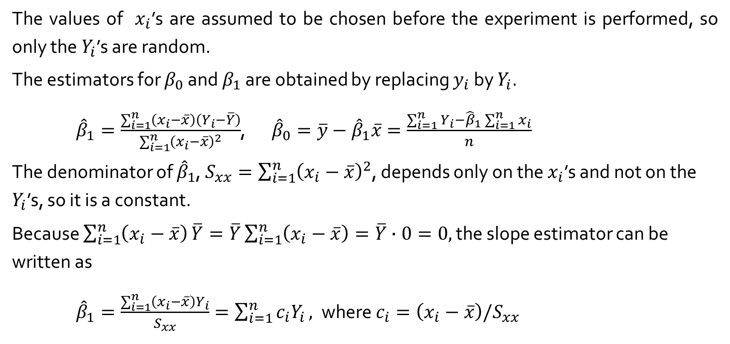
12.3 Inferences Ab0ut the Slope Parameter $β_{1}$
The values of $x_{i}$’s are assumed to be chosen before the experiment is performed, so only the $Y_{i}$’s are random.
The estimators for $β_{0}$ and $β_{1}$ are obtained by replacing $y_{i}$ by $Y_{i}$.
${\hat{β}}_{1}=\frac{\sum_{i=1}^{n}{\left(x_{i}−\overline{x}\right)\left(Y_{i}−\overline{Y}\right)}}{\sum_{i=1}^{n}{{\left(x_{i}−\overline{x}\right)}^{2}}}$, ${\hat{β}}_{0}=\overline{y}−{\hat{β}}_{1}\overline{x}=\frac{\sum_{i=1}^{n}{Y_{i}}−{\hat{β}}_{1}\sum_{i=1}^{n}{x_{i}}}{n}$
The denominator of ${\hat{β}}_{1}$, $S_{xx}=\sum_{i=1}^{n}{{\left(x_{i}−\overline{x}\right)}^{2}}$, depends only on the $x_{i}$’s and not on the $Y_{i}$’s, so it is a constant.
Because $\sum_{i=1}^{n}{\left(x_{i}−\overline{x}\right)}\overline{Y}=\overline{Y}\sum_{i=1}^{n}{\left(x_{i}−\overline{x}\right)}=\overline{Y}∙0=0,$ the slope estimator can be written as
${\hat{β}}_{1}=\frac{\sum_{i=1}^{n}{\left(x_{i}−\overline{x}\right)Y_{i}}}{S_{xx}}=\sum_{i=1}^{n}{{c_{i}Y}_{i}},$where $c_{i}=\left(x_{i}−\overline{x}\right)/S_{xx}$

Slide 2
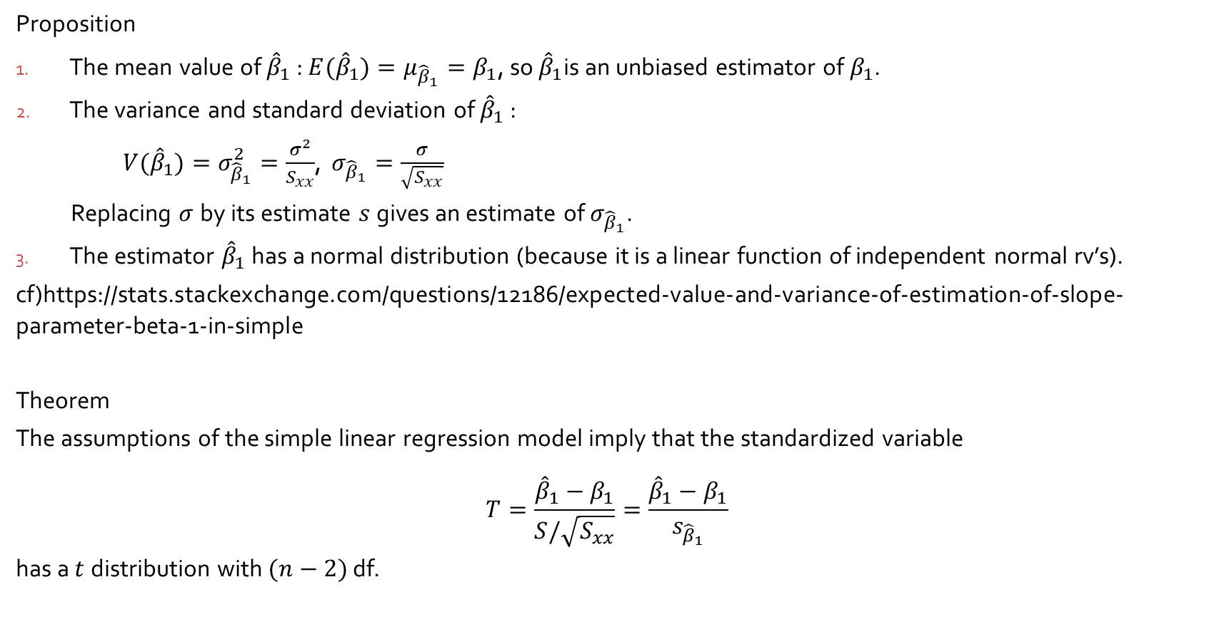
12.3 Inferences Ab0ut the Slope Parameter $β_{1}$
Proposition
The mean value of ${\hat{β}}_{1}$ : ${E(\hat{β}}_{1})=μ_{{\hat{β}}_{1}}=β_{1}$, so ${\hat{β}}_{1}$is an unbiased estimator of${ β}_{1}$.
The variance and standard deviation of ${\hat{β}}_{1}$ :
${V(\hat{β}}_{1})=σ_{{\hat{β}}_{1}}^{2}=\frac{σ^{2}}{S_{xx}}$, $σ_{{\hat{β}}_{1}}=\frac{σ}{\sqrt{S_{xx}}}$
Replacing $σ$by its estimate $s$gives an estimate of $σ_{{\hat{β}}_{1}}$.
The estimator ${\hat{β}}_{1}$ has a normal distribution (because it is a linear function of independent normal rv’s).
cf)https://stats.stackexchange.com/questions/12186/expected-value-and-variance-of-estimation-of-slope-parameter-beta-1-in-simple
Theorem
The assumptions of the simple linear regression model imply that the standardized variable
$$T=\frac{{\hat{β}}_{1}−β_{1}}{S/\sqrt{S_{xx}}}=\frac{{\hat{β}}_{1}−β_{1}}{s_{{\hat{β}}_{1}}}$$
has a $t$distribution with $(n−2)$ df.

Slide 3
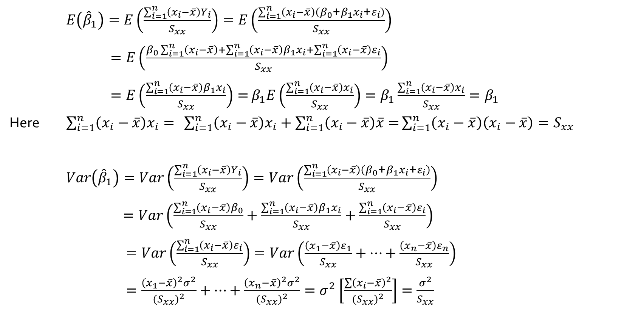
$E\left({\hat{β}}_{1}\right)=E\left(\frac{\sum_{i=1}^{n}{\left(x_{i}−\overline{x}\right)Y_{i}}}{S_{xx}}\right)=E\left(\frac{\sum_{i=1}^{n}{\left(x_{i}−\overline{x}\right)\left(β_{0}\text{+}β_{1}x_{i}\text{+}ε_{i}\right)}}{S_{xx}}\right)$
$=E\left(\frac{β_{0}\sum_{i=1}^{n}{\left(x_{i}−\overline{x}\right)+\sum_{i=1}^{n}{\left(x_{i}−\overline{x}\right)β_{1}x_{i}}+\sum_{i=1}^{n}{\left(x_{i}−\overline{x}\right)ε_{i}}}}{S_{xx}}\right)$
$=E\left(\frac{\sum_{i=1}^{n}{\left(x_{i}−\overline{x}\right)β_{1}x_{i}}}{S_{xx}}\right)=$ $β_{1}E\left(\frac{\sum_{i=1}^{n}{\left(x_{i}−\overline{x}\right)x_{i}}}{S_{xx}}\right)=β_{1}\frac{\sum_{i=1}^{n}{\left(x_{i}−\overline{x}\right)x_{i}}}{S_{xx}}=β_{1}$
Here $\sum_{i=1}^{n}{\left(x_{i}−\overline{x}\right)x_{i}}=$ $\sum_{i=1}^{n}{\left(x_{i}−\overline{x}\right)x_{i}}+\sum_{i=1}^{n}{\left(x_{i}−\overline{x}\right)\overline{x}=}\sum_{i=1}^{n}{\left(x_{i}−\overline{x}\right)\left(x_{i}−\overline{x}\right)}=S_{xx}$
$Var\left({\hat{β}}_{1}\right)=Var\left(\frac{\sum_{i=1}^{n}{\left(x_{i}−\overline{x}\right)Y_{i}}}{S_{xx}}\right)=Var\left(\frac{\sum_{i=1}^{n}{\left(x_{i}−\overline{x}\right)\left(β_{0}\text{+}β_{1}x_{i}\text{+}ε_{i}\right)}}{S_{xx}}\right)$
$=Var\left(\frac{\sum_{i=1}^{n}{\left(x_{i}−\overline{x}\right)β_{0}}}{S_{xx}}+\frac{\sum_{i=1}^{n}{\left(x_{i}−\overline{x}\right)β_{1}x_{i}}}{S_{xx}}+\frac{\sum_{i=1}^{n}{\left(x_{i}−\overline{x}\right)ε_{i}}}{S_{xx}}\right)$
$=Var\left(\frac{\sum_{i=1}^{n}{\left(x_{i}−\overline{x}\right)ε_{i}}}{S_{xx}}\right)=Var\left(\frac{\left(x_{1}−\overline{x}\right)ε_{1}}{S_{xx}}+⋯+\frac{\left(x_{n}−\overline{x}\right)ε_{n}}{S_{xx}}\right)$
$=\frac{{\left(x_{1}−\overline{x}\right)}^{2}σ^{2}}{{{(S}_{xx})}^{2}}+⋯+\frac{{\left(x_{n}−\overline{x}\right)}^{2}σ^{2}}{{{(S}_{xx})}^{2}}=σ^{2}\left[\frac{\sum{{\left(x_{i}−\overline{x}\right)}^{2}}}{{{(S}_{xx})}^{2}}\right]=\frac{σ^{2}}{S_{xx}}$

